Slide 1


Iris Flowers Dataset Analysis
Gao Yiming
Singapore University of Technology & Design
ISTD Senior

Slide 2
Dataset Chosen
Iris Data Set
From Fisher, 1936
Downloaded from: https://archive.ics.uci.edu/ml/datasets/Iris;

Slide 3
Dataset Description
150 data in total
Four features (sepal length, sepal width, petal length, petal width) for each data
Three classes: Iris Setosa, Iris Versicolour and Iris Virginica.

Slide 4
Dataset Description
sepal-length | sepal-width | petal-length | petal-width
count | 150.000000 | 150.000000 | 150.000000 | 150.000000
mean | 5.843333 | 3.054000 | 3.758667 | 1.198667
std | 0.828066 | 0.433594 | 1.764420 | 0.763161
min | 4.300000 | 2.000000 | 1.000000 | 0.100000
25% | 5.100000 | 2.800000 | 1.600000 | 0.300000
50% | 5.800000 | 3.000000 | 4.350000 | 1.300000
75% | 6.400000 | 3.300000 | 5.100000 | 1.800000
max | 7.900000 | 4.400000 | 6.900000 | 2.500000

Slide 5
Data Quality Assessment
Data Integrity: There is no missing data and no repeat line
Data Consistency: All data has value for the four features and the values are comparable.
Data Accuracy: Not sure for this. I assume all data is accurate based on preservation.

Slide 6
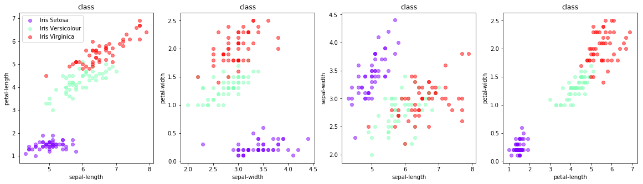
Dataset Visualisation

Slide 7
Data Visualization
From the dot plot, we can easily find some patterns for three classes:
For Sentosa, the sepal width/length does not change with petal width/length. But for the other two classes, if a sample has a long/wide sepal, it is more likely to have a long/wide petal.
The sepal/petal width increases with its length for all three classes, although the value differs.

Slide 8
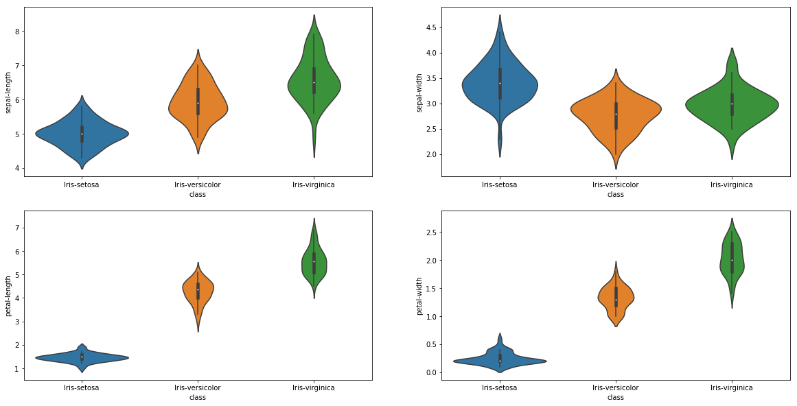
Data Visualization
From the violin plot we can have some straight view on the kernel probability density of the data at different values.

Slide 9
Preprocessing
First, I split the dataset into training set and test set. The split rate is 0.75 : 0.25.
I randomize the training set at random_state = 2.
I tried to use StandardScaler to do standardization on the training set, but the accuracy falls. I think it is because I use only 120 samples for training and there is not much noise in the data, the standardization does not give much help to this case.

Slide 10
Model Training
Because we want to find ten most similar points to the input sample, I choose k nearest neighbors as the training algorithm.
I use k = 10 and weight = 'uniform' for the classifier.
The algorithm computes distance between data points and returns ten nearest neighbors for a given point.

Slide 11
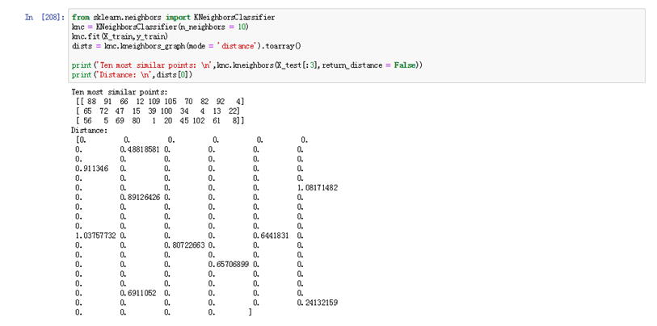
Ten most similar points and shortest distances

Slide 12

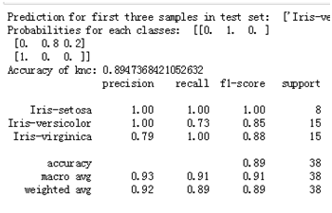

Prediction & Evaluation
We are also able to get the predicted class for the given data. In one test the accuracy is 0.8947, and the classification report shows that the f1 score for Sentosa is much higher than the other two classes, which means this model performs well when classifying Setosa flowers.

Slide 13
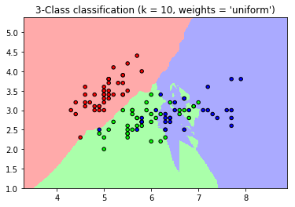
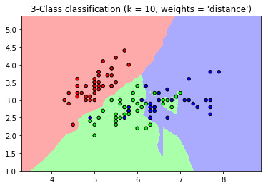
Classification Graph
The decision boundaries for each class (Blue - Sentosa, Green - Versicolour, Red - Virginica). I use one-hot encode to transform y from strings to digits (0,1,2).

Slide 14
Thank you!

